Slide 1
Agenda Item 16 Results of Regional Coordination Platform and how to enhance our engagement with Regions
11th Meeting of KSC Steering Committee
Pampanga, Philippines
(12-14 June 2019)
SAI-India

Slide 2
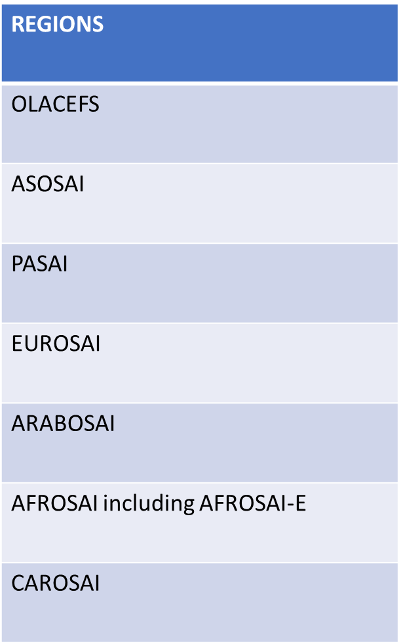
INTOSAI GLOBAL BODIES
REGIONS
IRCP
INTOSAI GLOBAL BODIES
GOAL CHAIRS | PSC
 | CBC
 | KSC | WGs
 | PFAC
IDI
INTOSAI SECRETARIAT
INTOSAI JOURNAL
SCEI

Slide 3
KSC and Regions Cooperation
Strengthening our relationship with Regional bodies has been under deliberations in past KSC SC meetings.
Use of INTOSAI Community Portal and Participation in Regions Meetings considered vital for engaging the Regions.
Regional Meetings
KSC attends INTOSAI Regions Coordination Platform meetings.
SAI Mexico in OLACEFs
SAI India in ASOSAI and CAROSAI Congress.
Template for reporting KSC work prepared
Uganda has agreed to represent in AFROSAI Meetings
France is considering representing KSC in EUROSAI Meetings.
Yet to be represented at ARABOSAI, PASAI, CREFIAF
INTOSAI Community Portal
Regions shown interest in using Communities of Practice and Video Conferencing facility
OLACEFS and PASAI to contribute to the library of the Portal.
AFROSAI has expressed interest in having a page in the Portal
ARABOSAI has opened Communities of Practice for ARABOSAI - AFROSAI-E cooperation in the Portal.

Slide 4
IRCP Deliberations – Issues for Discussion
Quality and utility of the Products | Auditing of SDGs | Limitations to accessing Knowledge resources
Quality of exposure process Translate before exposure | Need for capacity development, methodology, eLearning and knowledge sharing for Audit of implementation of SDG programmes | Multiple websites with restricted access Low awareness of accessible knowledge resources Lack of clarity on purposes of INTOSAI website vs. Community Portal
Seek assistance for translation of Exposure documents Encourage Regions for better response | To commence KSC-IDI Programme on implementation of SDGs Create CoP on SDGs and seek participation of WGs Populate knowledge centre with case studies, documents related to SDGs | Promote enhanced awareness and usage of Community Portal Consider identifying focal persons from each Region as communication liaisons Seek regional assistance for translation of content developed in the current plan

Slide 5
Additional Issues for discussion
Identify representatives for the PASAI, ARABOSAI and CREFIAF Regions’ Meetings
Create Standard Template for communication with Regional organisations
Regular feedback from the WG on the challenges and support sought from the Regions will enable KSC to discuss these during IRCP meetings.
Issues that can be covered in the Regions Meetings:
Advocate the necessity of cooperation between KSC and the Regions in knowledge sharing activities for better synergies.
Gather Support of the Regions in the Working Group activities.
WGEI has expressed difficulties in obtaining regional participation in EI activities.

Slide 6
THANK YOU

